Slide 1
CREATIVE PORTFOLIO
Website Design &
Amazon Creative Content
Jenna Van Bemmel
Conversion-focused product page & marketplace creative — before & after

Slide 2

SECTION 01
Website Creative
Redesigning Purity Products' on-site product experience for clarity, trust, and conversion.

Slide 3
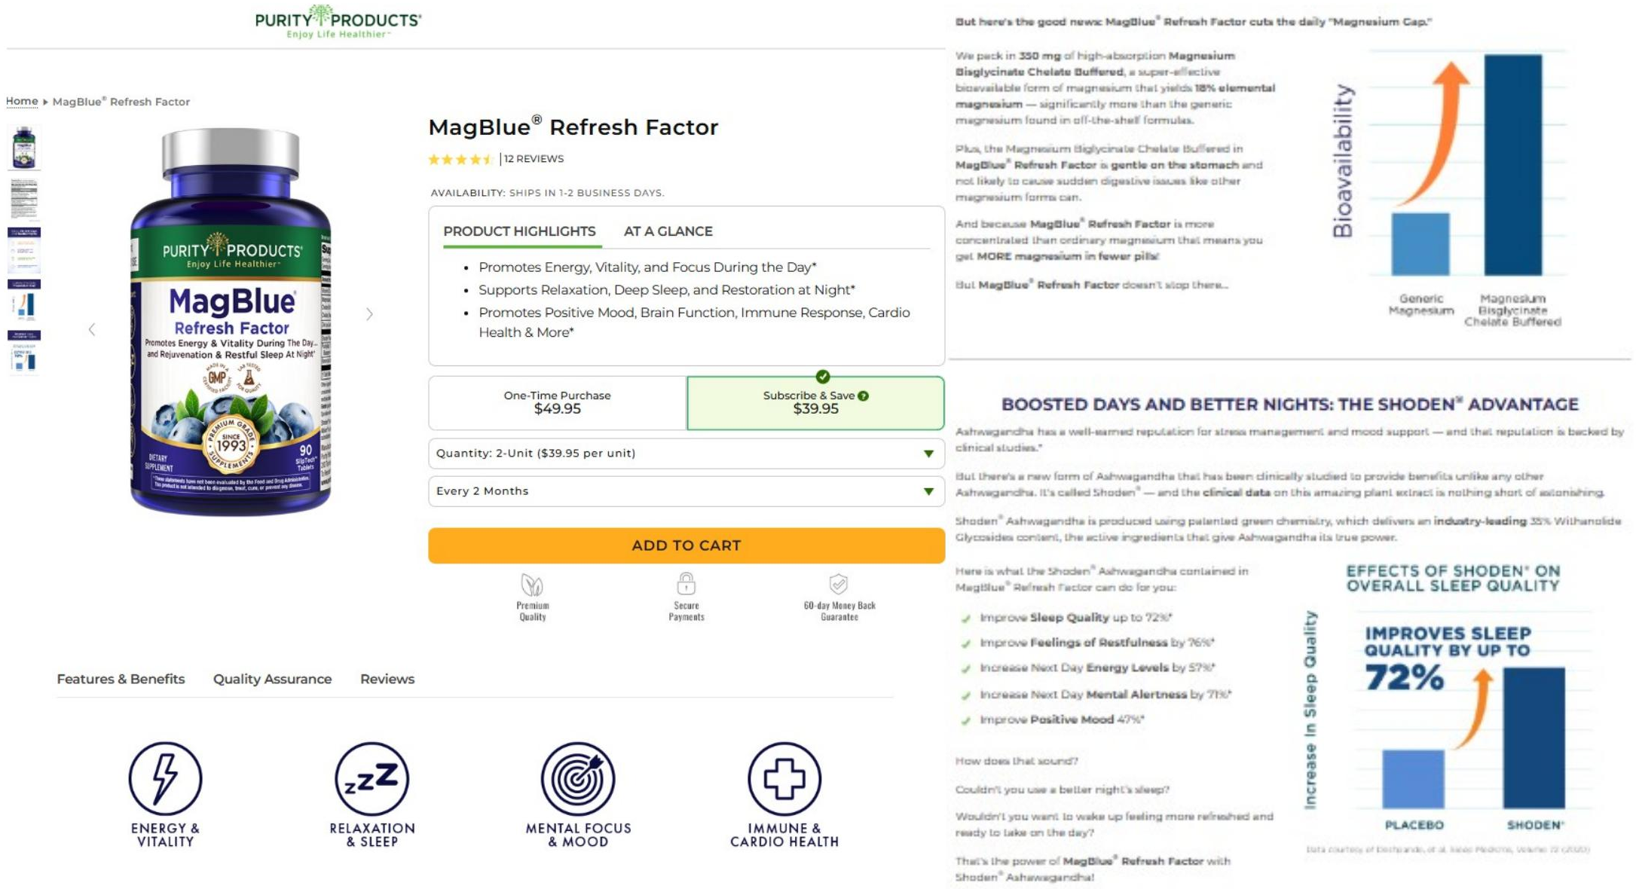
BEFORE
MagBlue® Refresh Factor — Product Page
Legacy design dense blocks, competing text columns, and weak visual hierarchy dilute the key benefits.

Slide 4
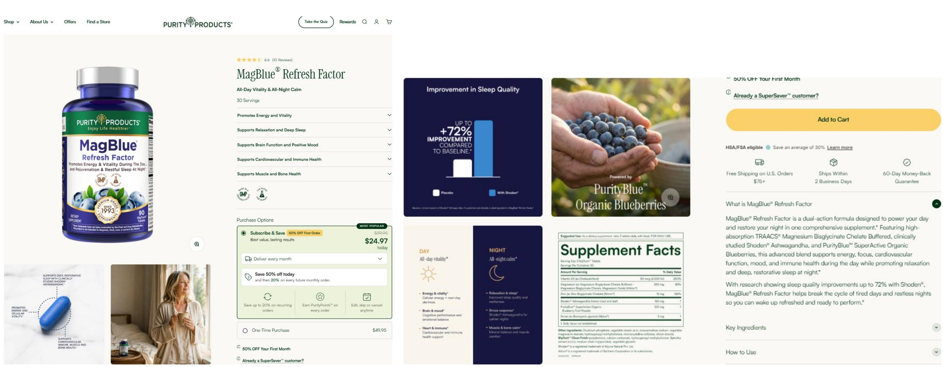
AFTER
MagBlue® Refresh Factor — Product Page
Improvement cleaner hierarchy, scannable benefit accordions, and a focused purchase path lift comprehension.

Slide 5
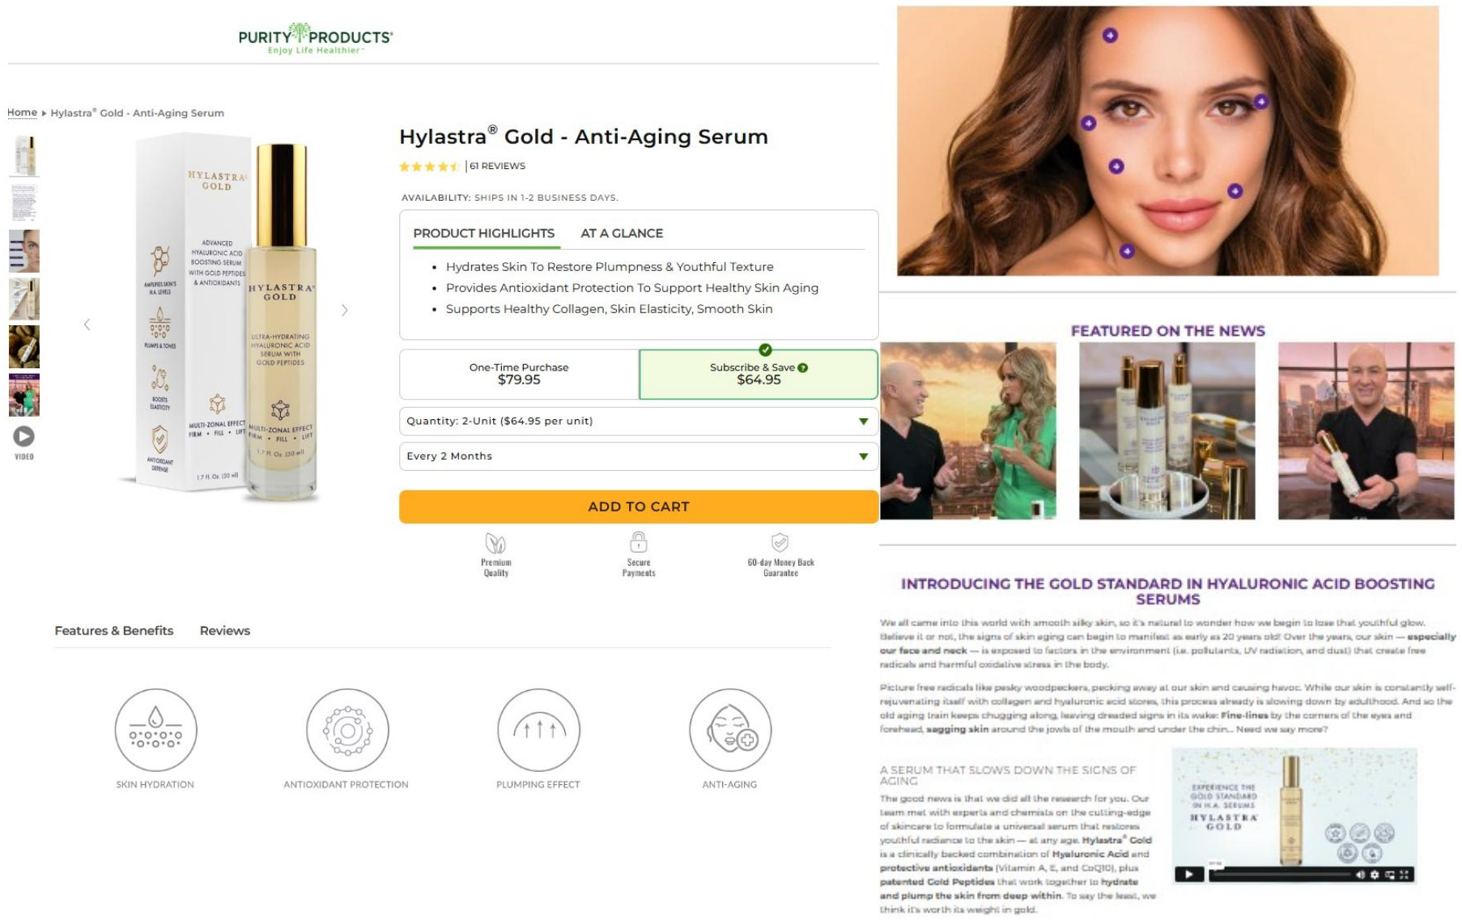
BEFORE
Product Detail — Legacy Layout
Legacy design cluttered supporting sections make the value proposition hard to follow at a glance.

Slide 6
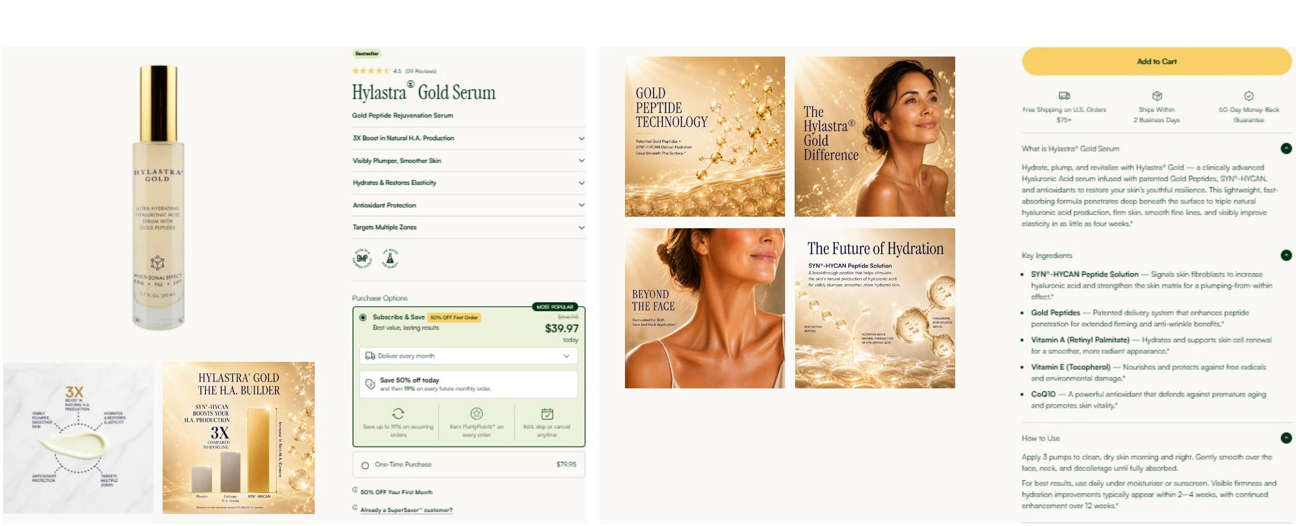
AFTER
Product Detail — Redesigned
Improvement modular sections, confident whitespace, and elevated imagery strengthen brand feel.

Slide 7
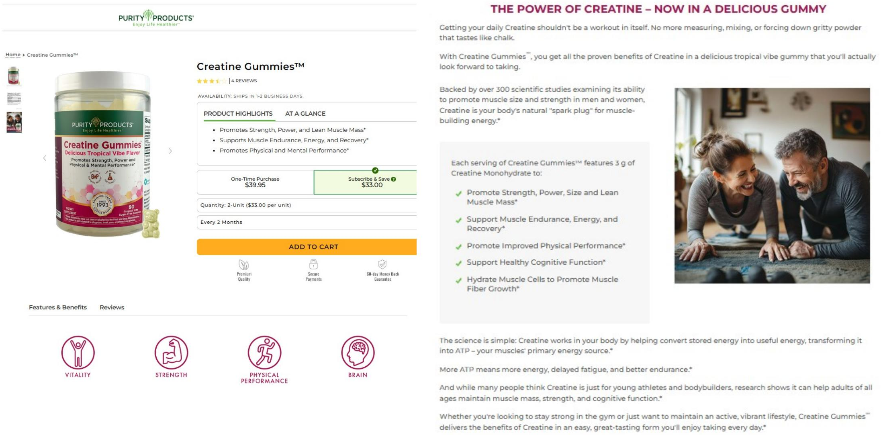
BEFORE
Supporting Content — Legacy Layout
Legacy design long-form copy and inconsistent spacing bury the proof points and CTAs.

Slide 8
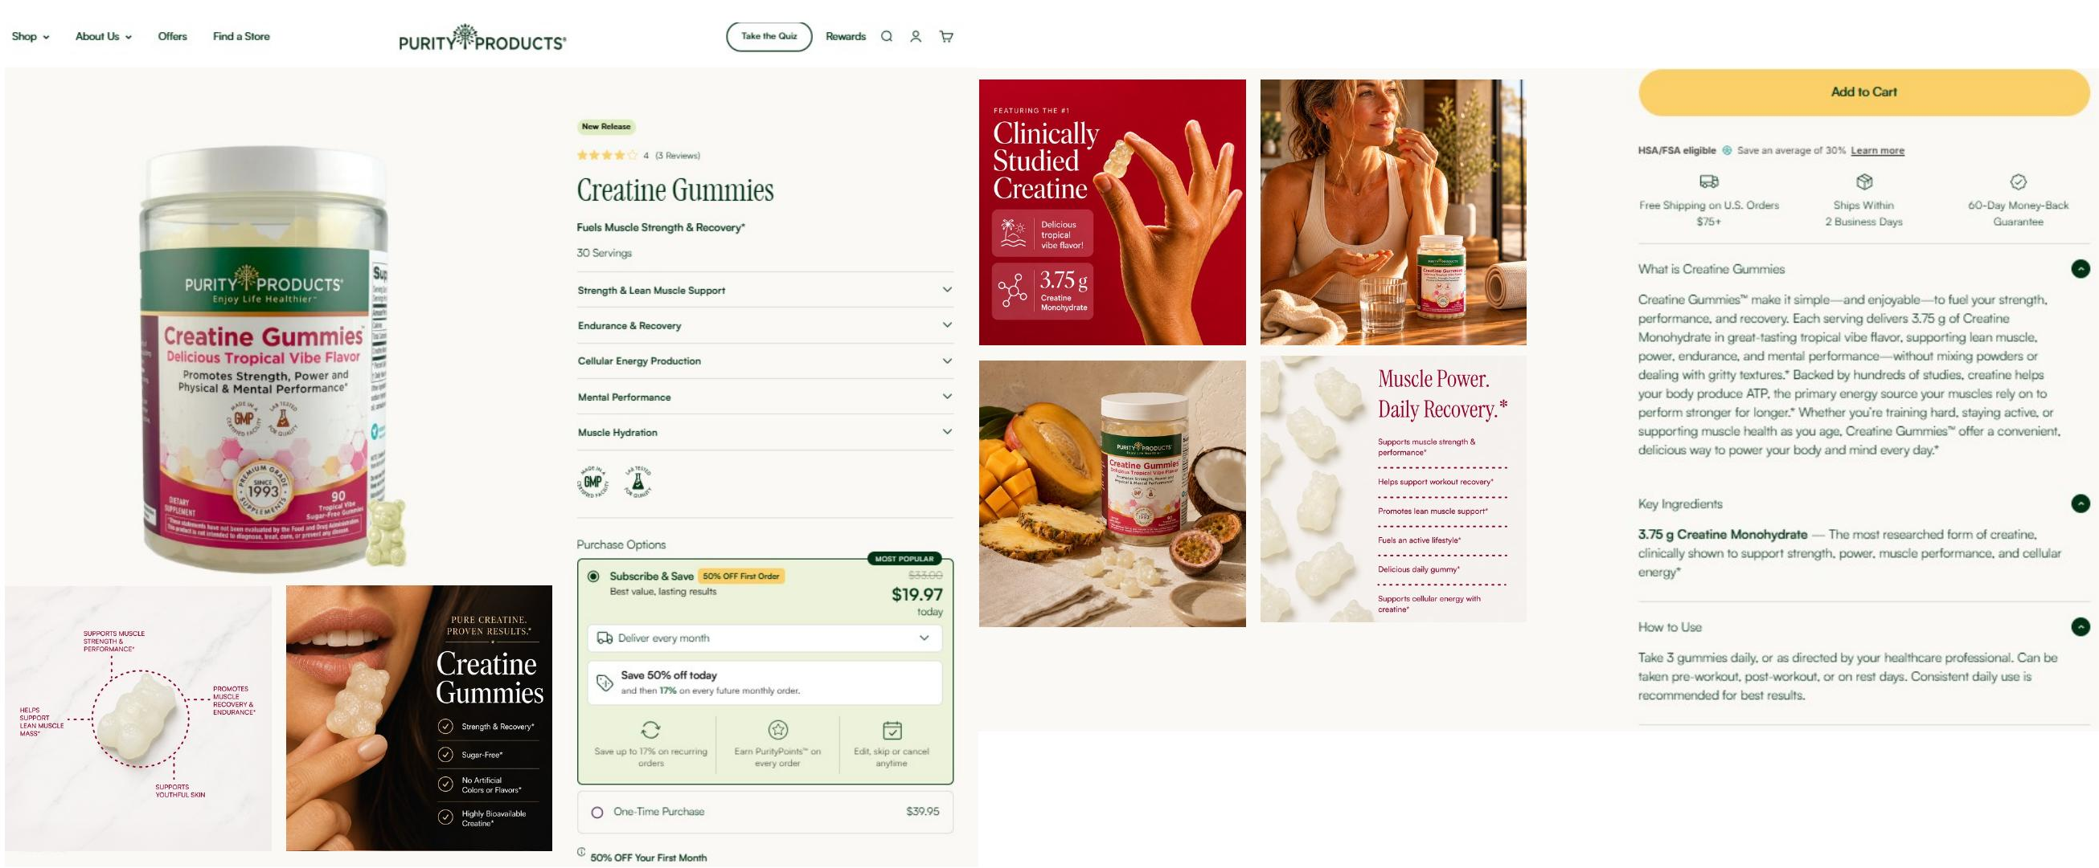
AFTER
Supporting Content — Redesigned
Improvement structured storytelling and consistent components guide the eye toward action.

Slide 9

SECTION 02
Amazon Creative
Rebuilding the marketplace listing and A+ content to win the click and the buy box.

Slide 10
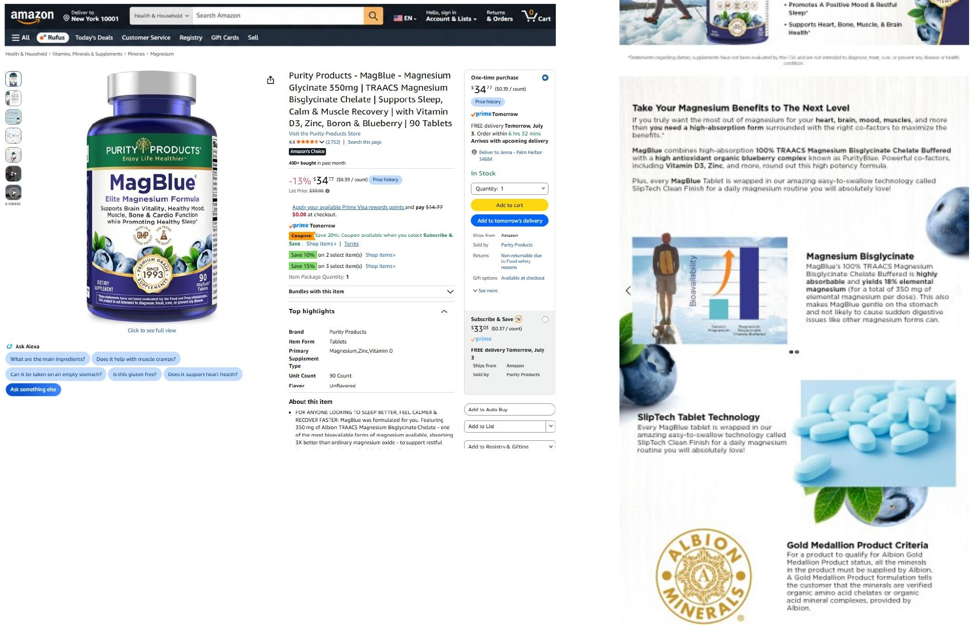
BEFORE
Amazon Listing — Legacy A+ Content
Legacy design flat modules and inconsistent styling underuse Amazon's premium content real estate.

Slide 11
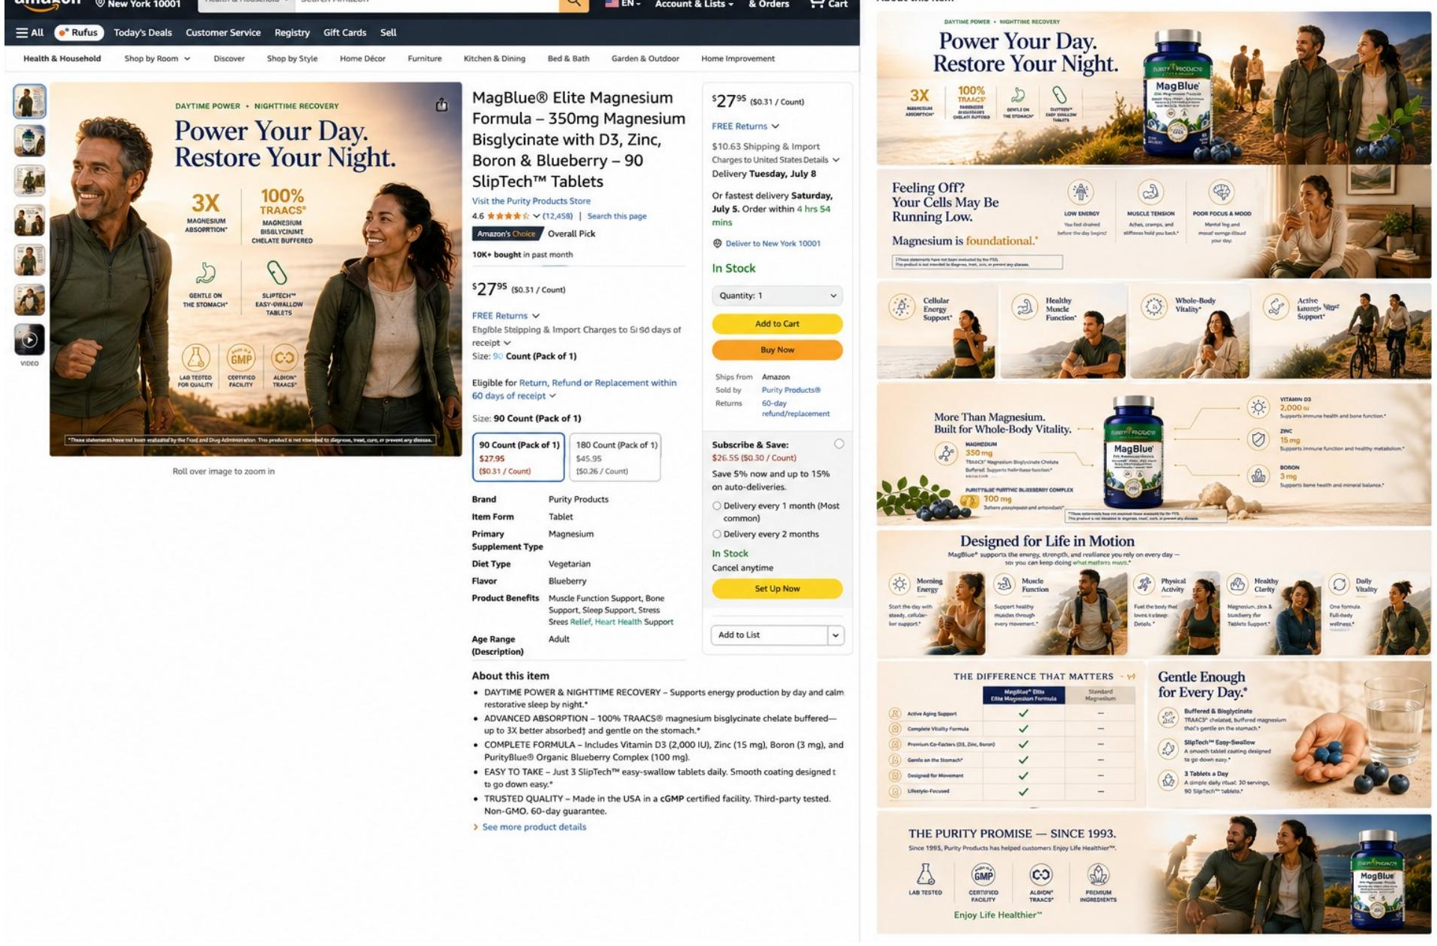
AFTER
Amazon Listing — Redesigned A+ Content
Improvement lifestyle-led modules, clear benefit callouts, and a cohesive system build trust fast.

Slide 12
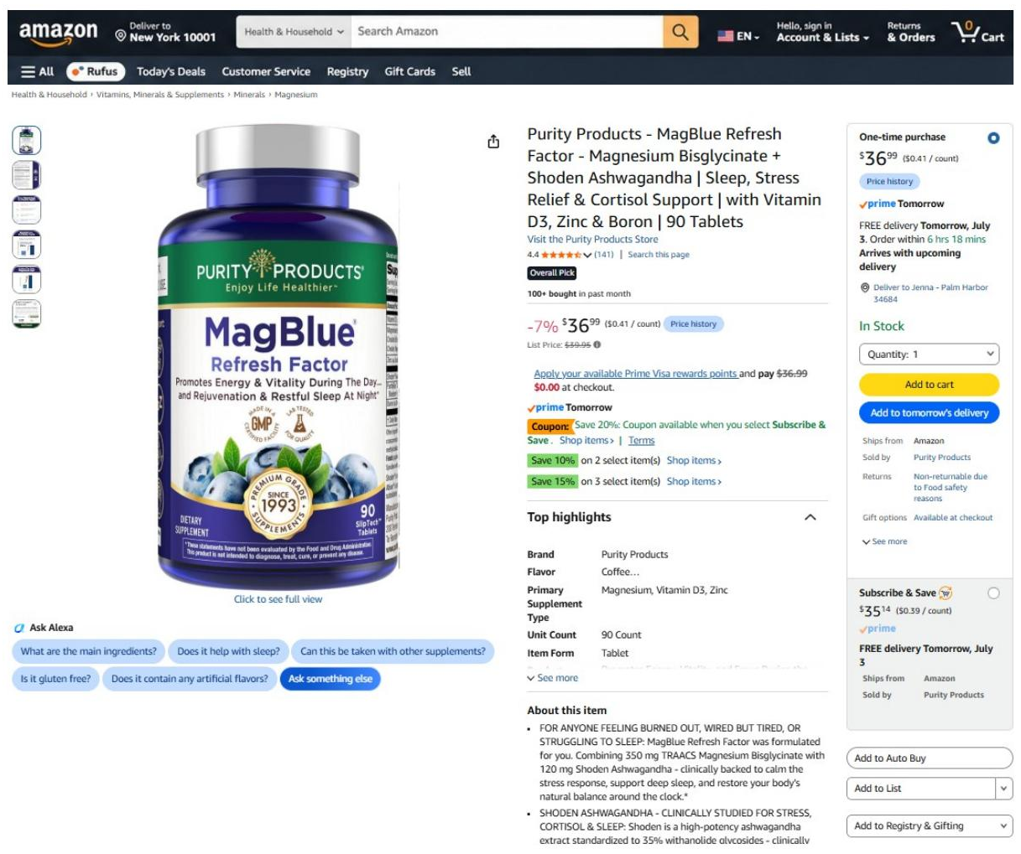
BEFORE
Detail Page — Legacy Presentation
Legacy design standard imagery and copy blend into the category with little differentiation.

Slide 13
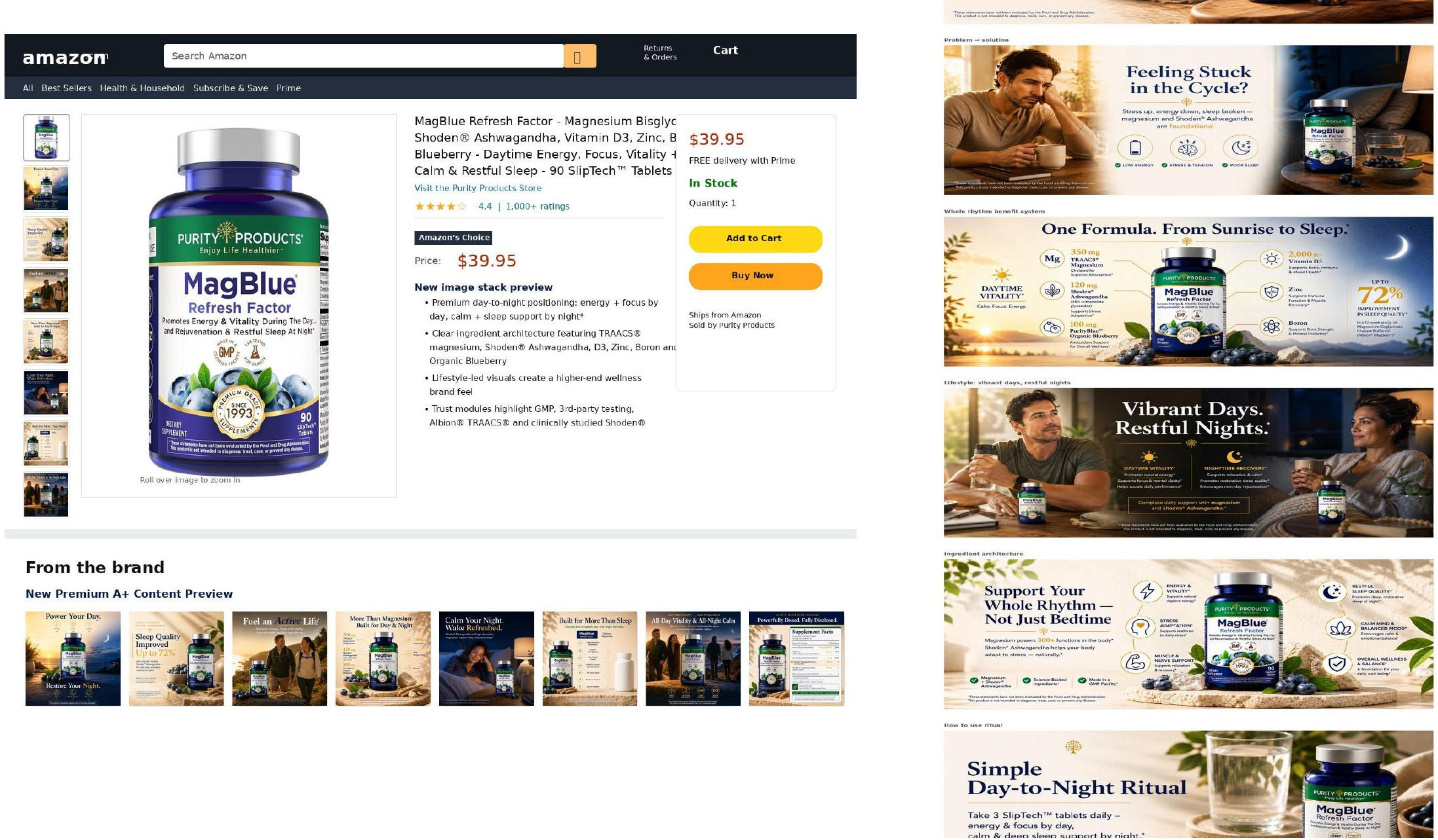
AFTER
Detail Page — Redesigned
Improvement polished hero, structured highlights, and brand-forward visuals lift conversion.

Slide 14
THANK YOU
Let's build creative that converts.
Jenna Van Bemmel · Website & Amazon Creative Portfolio

